Slide 1
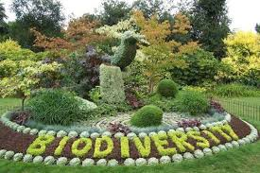
Biodiveristy Capstone Project
04/04/18
Investigating Protected Species

Slide 2
Description of data in species_info.csv
A section describing the data in species_info.csv. Be sure to include some (or all) of what you noticed while working through the notebook.
the information contained is the dataframe species_info.csv :
index category,
scientific_name,
common_names
conservation_status
There are 5541different species in the species DataFrame ➔ species_count = 5541.

Slide 3
Description of data in species_info.csv 2
There are 7 categories ( species type) in the DataFrame species, which are :
Mammal
Bird
Reptile
Amphibian
Fish
Vascular Plant
- Nonvascular Plant
The different values of conservation status are : nan, 'Species of Concern' 'Endangered’, 'Threatened’ and 'In Recovery'

Slide 4
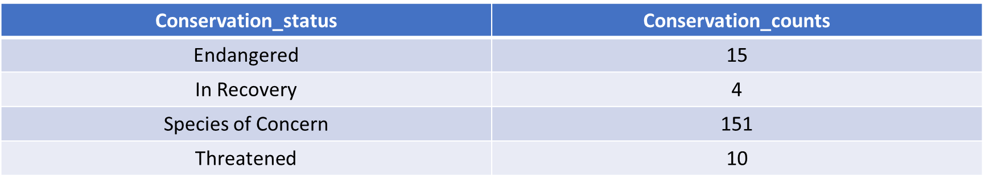
Species Conservation Status Analysis
Number of scientific_names for each conservation_status criteria are:
We notice that we have a conservation status for only 180 species, but we found that there far more than that. Only a small number of species are categorized as needing some sort of protection. The rest have conservation_status equal to None, or NaN.

Slide 5
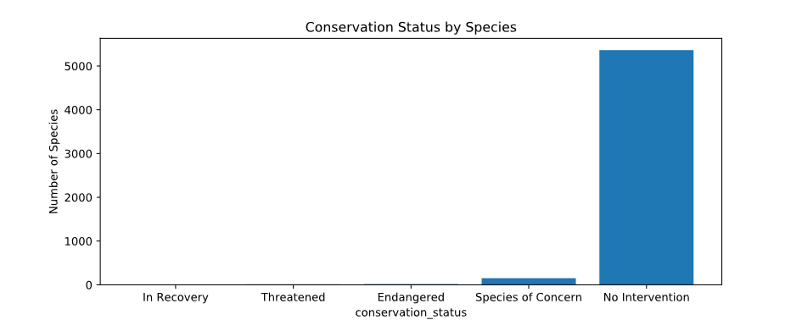
Conservation_counts_fixed
conservation_status scientific_name
1 In Recovery 4
4 Threatened 10
0 Endangered 15
3 Species of Concern 151
2 No Intervention 5363

Slide 6
Significance calculations for endangered status between different categories of species
Mammals 17% and birds 15% are on the top of the categories that are protected ➔ it seems that both of them are likely to be more endangered.
category | not_protected | Protected | percent_protected
Amphibian | 72 | 7 | 0.088608
Bird | 413 | 75 | 0.153689
Fish | 115 | 11 | 0.087302
Mammal | 146 | 30 | 0.170455
Nonvascular Plant | 328 | 5 | 0.015015
Reptile | 73 | 5 | 0.064103
Vascular Plant | 4216 | 46 | 0.010793

Slide 7
Recommendation for conservationists concerned about endangered species
pval_mammals_birds = 0.688 > 0.05 ➔ we fail to reject the null hypothesis there is no significant difference between Mammals and Birds : the difference is due to chance.
pval_reptile_mammal = 0.038<0.05➔ we reject the null hypothesis there is a significant difference between Mammals and reptiles, the difference is not due to chance.
pval_reptile_mammal = 0.7>0.05, then we fail to reject the null hypothesis there is no significant difference between fish and reptiles, the difference is due to chance.
pval_nonvascular_reptile = 0.033<0.05, then we reject the null hypothesis there is a significant difference between non vascular and reptiles, the difference is not due to chance.
pval_fish_amphibian = 0.82 > 0.05, then we fail to reject the null hypothesis there is no significant difference between non fish and Amphibians, the difference is due to chance
➔ Conservationists should focus on both Mammals and Birds regarding the protection in comparison with other categories. They are more likely to be endangered.
➔ Only small proportion of species are protected; percent_protected values are less than 15,50%

Slide 8
Sample size of Foot and Mouth Reduction Effort
baseline = 15
minimum_detectable_effect = 33.33
sample_size_per_variant = 870
yellowstone_weeks_observing = 870 / 507
at yellowstone_weeks_observing the scientists need 1.7 weeks; 12 days
bryce_weeks_observing = 870 / 250
at bryce_weeks_observing the scientists need 3.5 weeks; 24.5 days

Slide 9
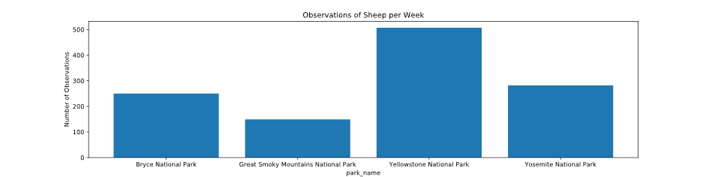
Observations of sheep per week
park_name observations
Bryce National Park 250
Great Smoky Mountains National Park 149
Yellowstone National Park 507
Yosemite National Park 282

Slide 10
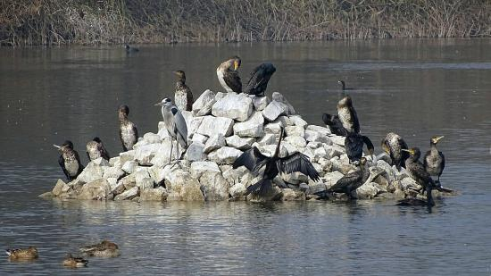
Thanks

